Slide 1
leveraging a Web service with C#
U.M. St. Louis – Information systems 3844 & 6805

Slide 2
The use case we’re using here
We want to get data about a client.
We could use the Clearbit Enrichment API as one method of accomplishing that goal.
We have in our possession that client’s e-mail address.
We can send a request containing that e-mail address to that service and leverage the returned data to our competitive advantage.

Slide 3
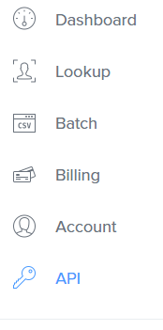
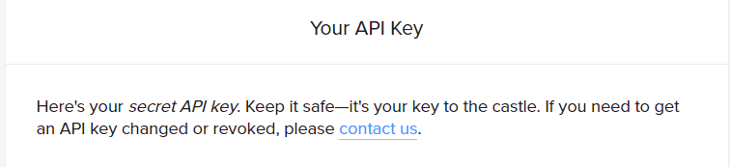
The web service we’re using here
The Clearbit Enrichment API responds to requests with data mined about the owner of an e-mail address.
Go to https://clearbit.com and sign up for an account.
Paste your secret API key as the value for the username in the GetResponses method you can find in the source file.
string userName = “YOUR API KEY";
(Line 68 of the source file.)

Slide 4
The apis we’re using here
The Clearbit Enrichment Web Service
https://clearbit.com/enrichment
JSON.NET
http://www.newtonsoft.com/json
https://www.nuget.org/packages/Newtonsoft.Json/
Apache NPOI
http://poi.apache.org/
https://www.nuget.org/packages/NPOI/

Slide 5
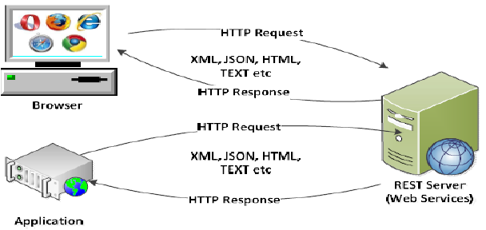
Request to A RESTful web service (rest stands for representational state transfer)
https://www.researchgate.net/figure/281080973_fig2_Fig-2-RESTFul-Web-Service-Architecture

Slide 6
Handling the request and response
String[] e-mails = { "alex@alexmaccaw.com", "lachy@stripe.com", "harlow@clearbit.com" };
void GetResponses()
{
responses = new String[e-mails.Length];
for(int i = 0; i < e-mails.Length; i++)
{
WebRequest request = WebRequest.Create("https://person-stream.clearbit.com/v2/combined/find?e-mail=" + e-mails[i]);
request.Method = "GET";
string userName = “YOUR API KEY";
string password = "";
string credentials = userName + ":" + password;
request.Headers["Authorization"] = "Basic " + Convert.ToBase64String(Encoding.ASCII.GetBytes(credentials));
WebResponse response = request.GetResponse();
Stream dataStream = response.GetResponseStream();
StreamReader reader = new StreamReader(dataStream);
responses[i] = reader.ReadToEnd();
}
}

Slide 7
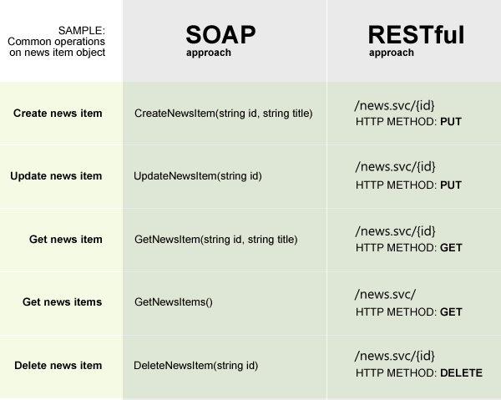
the request
WebRequest request = WebRequest.Create("https://person-stream.clearbit.com/v2/combined/find?e-mail= alex@alexmaccaw.com");
http://docs.sitefinity.com/for-developers-web-services

Slide 8
Terminology for Json (Javascript object notation)
Root schema
Subschema
Property
Child instance
Element
Object
Array

Slide 9
Terminology for Json (Javascript object notation)
Subschema
Child Instance Array
"company": {
"id": "54fa90d8-7ba7-4b6d-b5ec-82ee3e184166",
"domainAliases": [
"stripe.io",
"stripe.co.nz",
"stripe.uk",
"stripe.ie",
"stripe.cm"
],
"site": {
"url": "http://stripe.com",
"title": "Stripe",
"h1": "Stripe",
"metaDescription": "Stripe is a suite of APIs that powers commerce for businesses of all sizes.",
"metaAuthor": null,
"phoneNumbers": [
"+1 415-697-2918",
"+1 800-451-5817"
],
}
Property
Property Array
Scope of Property Object
And a root schema is one response from the Clearbit Enrichment API. Look in Docs/Sample_Root_Schemas in this repository to see what one response looks like.
Property Object
Child Instance

Slide 10
Complexities of parsing json
A property could be an object or an array.
Evaluate property.Value.HasValues and property.Value is JArray.
A child instance could be an object or an array.
The same course we used above, but we would check the childInstance.
An array element might contain an object.
Check the number of children the property or child instance contains.
If the array has at least one child and the child has children, the array element contains an object.

Slide 11
Sequence of events at runtime
Instantiate a request object containing a client’s e-mail address and your API key.
Instantiate a response object using the request object.
Save the JSON response to process it later.
Iterate through all the responses to find, for your header row, all the headers.
Iterate again through all the responses to align, with your data, your headers.
Iterate through the resulting rows to create your worksheets correspond to your subschemas.

Slide 12
The Use case for an enterprise environment
Your organization has a table of data about clients.
That table contains an e-mail address for each client.
Your boss wants your team to take advantage of that data and to integrate in the newest iteration of your organization’s marketing intelligence application a resource adapter leverages the Clearbit Enrichment API.

